Slide 1
Github Tutorial (just what u need to know)

Slide 2
Steps to commit to repo
Make your own branch from the Boring Club’s HFT Accelerator repository
Once you make your branch, you should have a cloned repository under your username (instead of TBCProjects/HFT-Accelerator, it will be (insert your username)/HFT-Accelerator
In your own branch, you can commit changes to the repository, and when you want to push to the TBCProjects repository, you create a pull request
You document your changes in the comments and await approval from owners of TBCProjects
I will be going around to assist those who have code already to push into their own folder and send to the repository

Slide 3
Testbenching
Notes:
Intros to officers. OFFICERS ARRIVE 15 MINS EARLY

Slide 4
Basics
In hardware, it can sometimes be difficult to observe whether you design is working or not with the human eye
We would need a way to observe the nanoseconds at which the waveforms are changing (way too fast to see with the human eye)
This is where testbenching comes in
Notes:
Josh talk about Bot if finished?

Slide 5
How it works
In addition to your module, you need to make another module (that will be your testbench) which instantiates the module you are trying to test
You manually set and clear the inputs in the testbench, essentially simulating what the circuit is going to do with a combination of different inputs
With testbenches, it is best to consider every edge case of your module to test its effectiveness under different conditions

Slide 6
How it fits into your project
Test benching will provide an easy way to see whether your logic is executing correctly and is giving the correct outputs before programming the hardware.
We will be using a software called ModelSim to test out the different trading modules

Slide 7
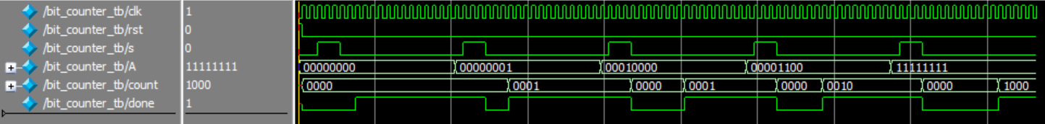
Testbench Example Waveform

Slide 8
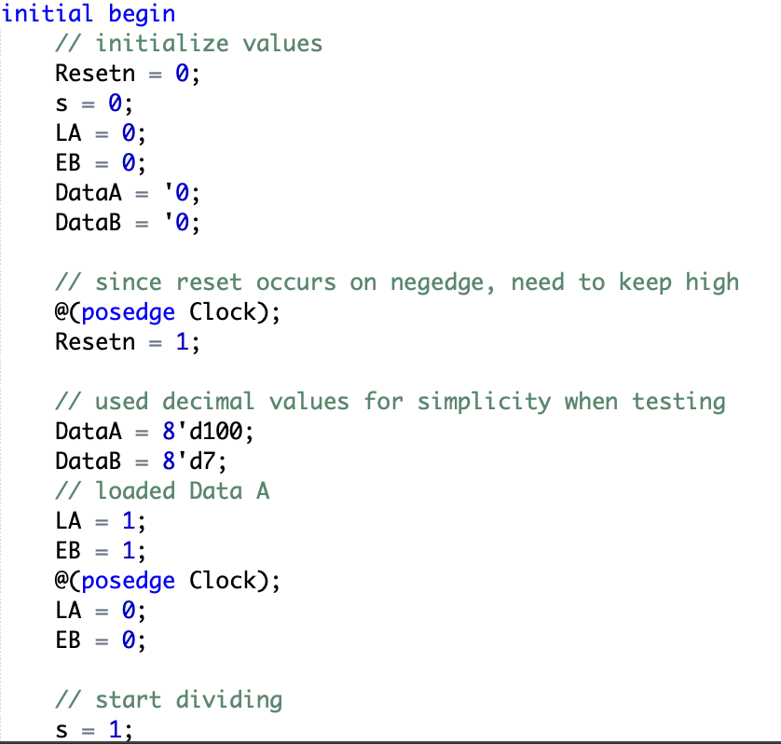
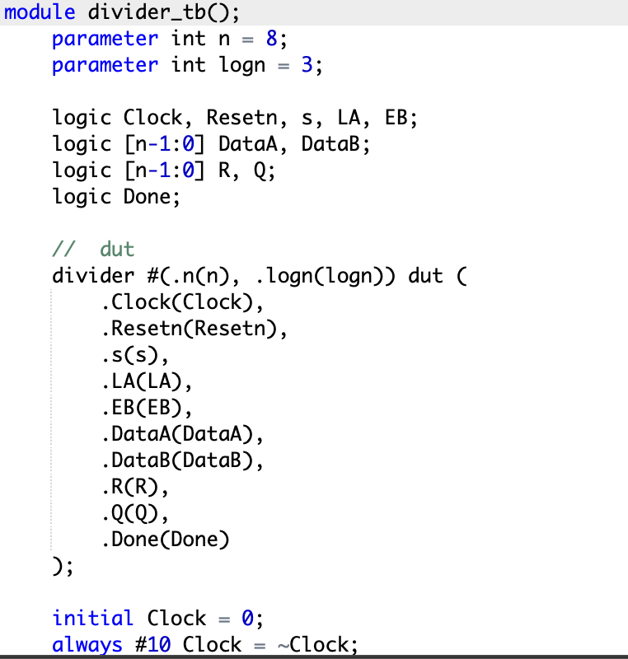
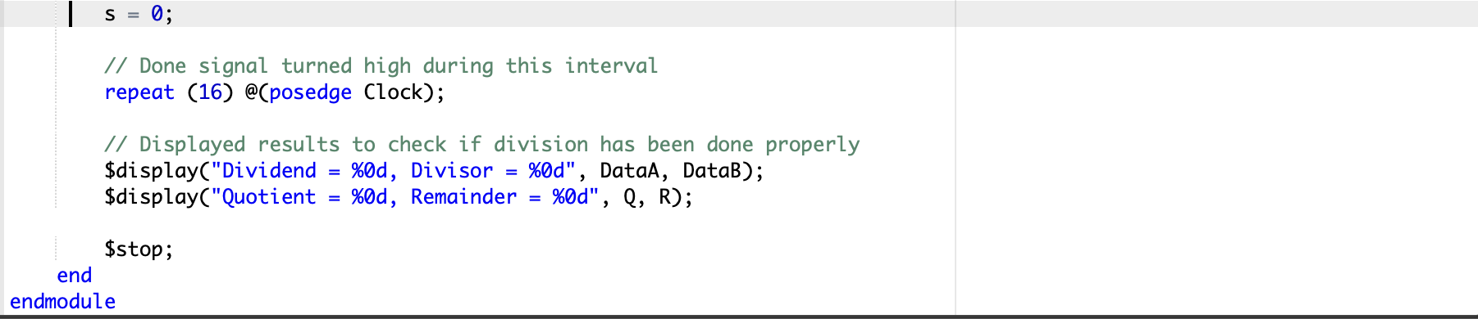
Testbench Module Example

Slide 9
Thanks for coming!

